Slide 1
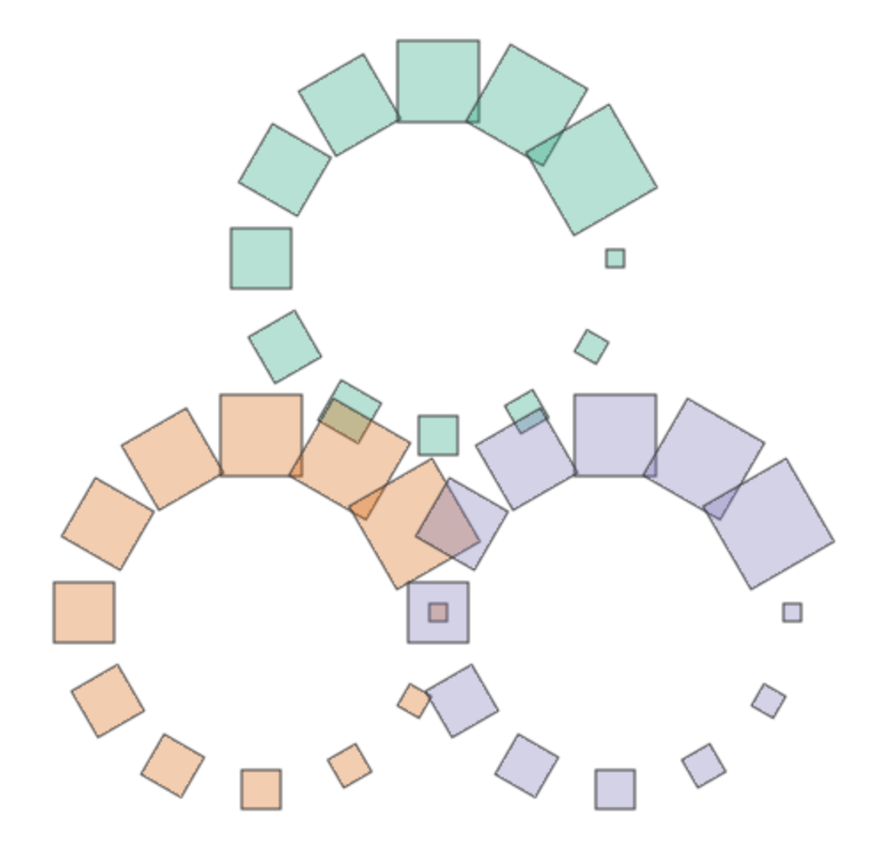
AI in Viz
A Samuel Pottinger
IDSV
Jan 16, 2026

Slide 2
Online Exclusive!
Follow up / updated lecture.
Generative AI has grown in popularity.
There are some ethical considerations.
Libraries like Sketchingpy have added llms.txt.
However, the rules and lessons haven’t really changed.

Slide 3
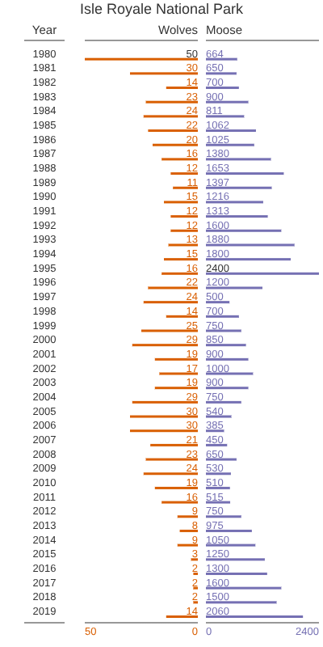
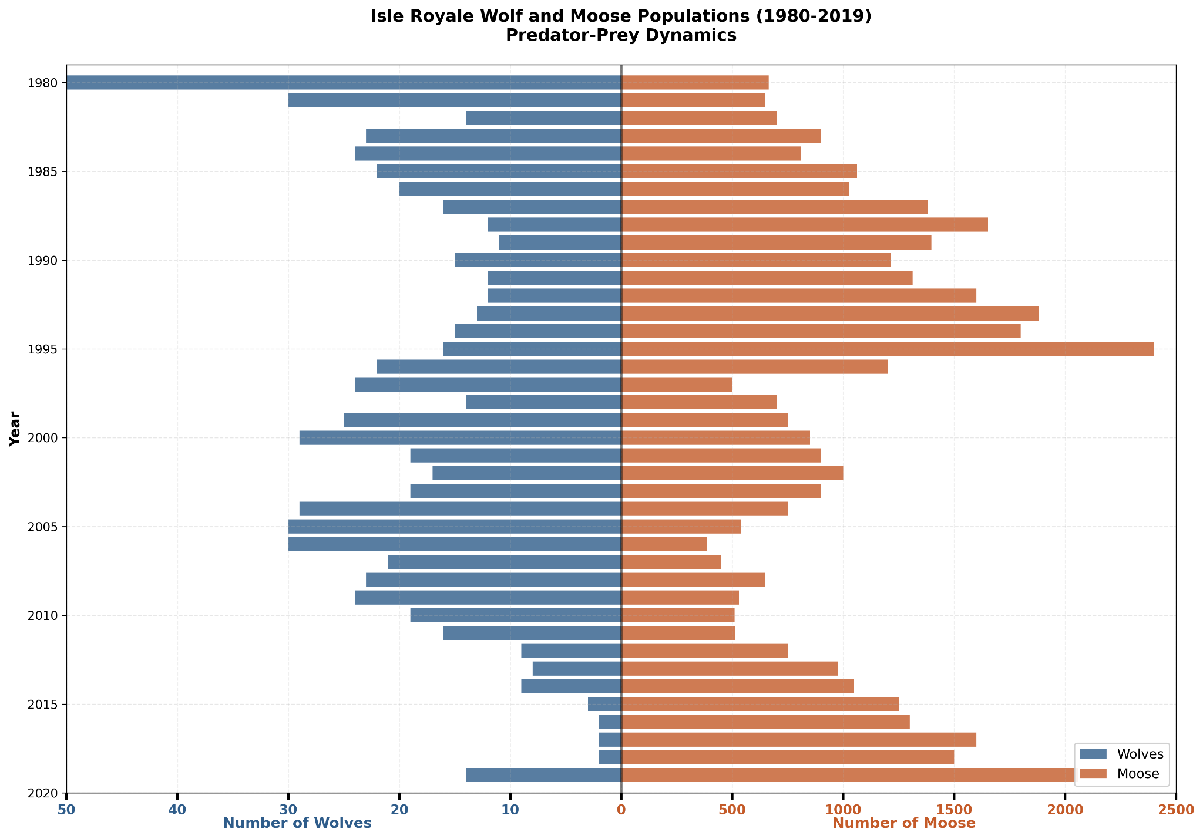
New Instruction
See tutorials 13 and 14
Requires AI Assistant like Claude

Slide 4
Role of AI
AI does not provide a silver bullet for understanding or visualizing data.
Limitations of language: it can be hard to describe what exactly is desired.
Don’t forget the role of iteration.
Integrating AI to augment user experience.
May provide some capabilities for novel interactions.
Outside the scope of this course.

Slide 5
Works Cited
[1] Anthropic, "Claude," Anthropic, 2024. Available: https://www.anthropic.com/claude
[2] J. Willison, "llms.txt," llmstxt Project, 2024. Available: https://llmstxt.org/
[3] A. Pottinger and Sketchingpy Contributors, "Sketchingpy," Sketchingpy Project, 2025. Available: https://sketchingpy.org/
[4] J. D. Hunter, "Matplotlib: A 2D Graphics Environment," *Computing in Science & Engineering*, vol. 9, no. 3, pp. 90-95, 2007, doi: 10.1109/MCSE.2007.55.
[5] Isle Royale National Park Michigan, "Wolf & Moose Populations." National Parks Service, Mar. 29, 2024. Available: https://www.nps.gov/isro/learn/nature/wolf-moose-populations.htm
[6] T. Gebru, "Eugenics and the Promise of Utopia through Artificial General Intelligence," IEEE Conference on Secure and Trustworthy Machine Learning (SaTML), 2023. Available: https://satml.org/2023/videos/

Slide 6


