Slide 1
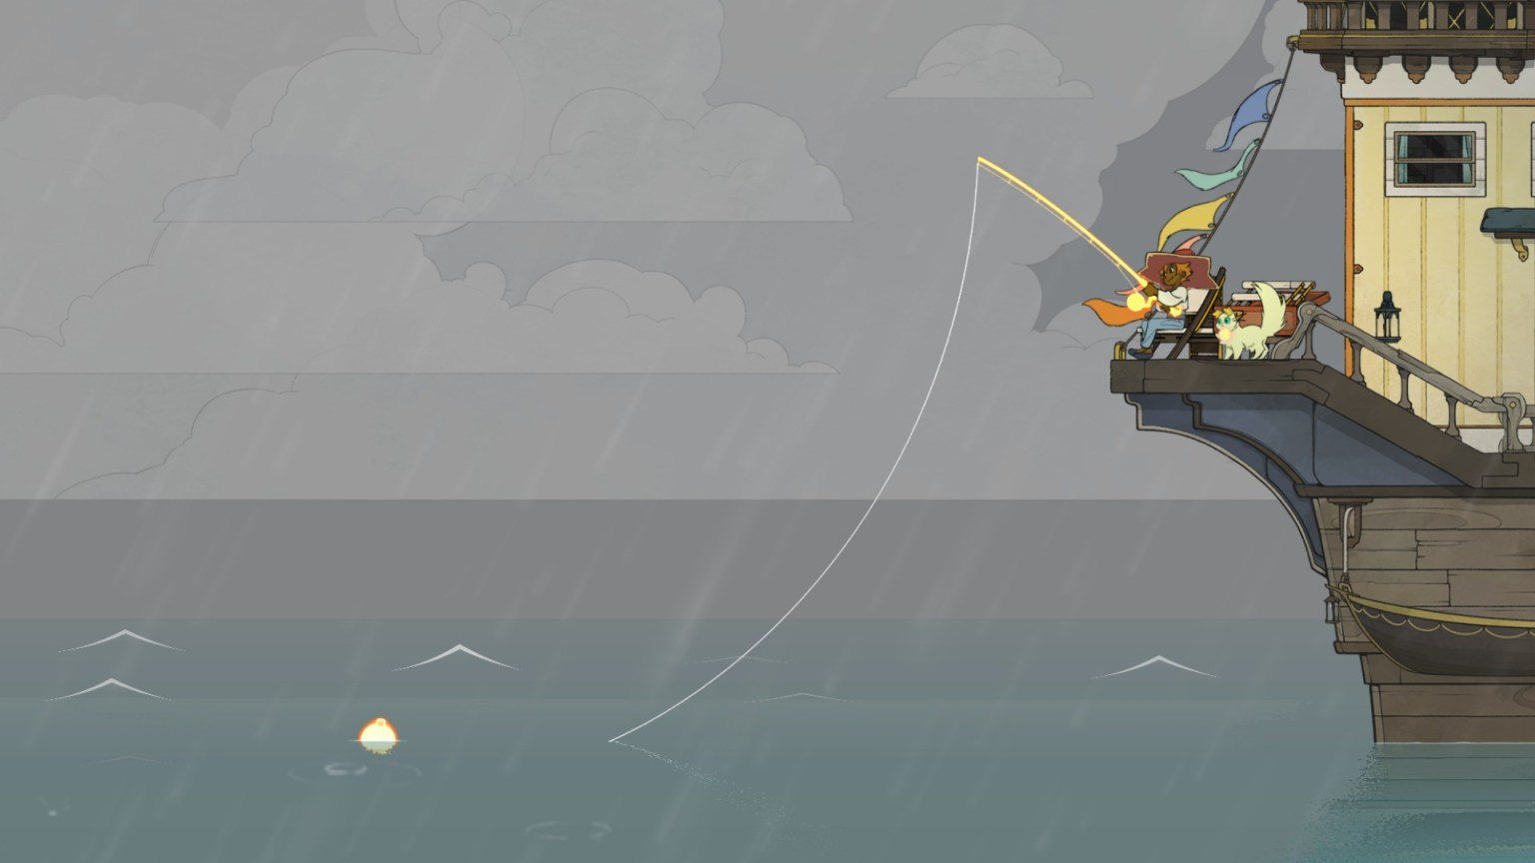
Interactive Experience
A Samuel Pottinger
Stat 198: IDSV
April 9, 2025

Slide 2
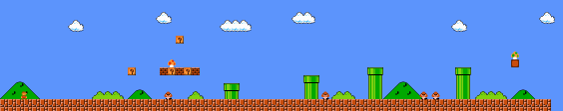
One last thing...
Player loops:
Primary loop: What’s the moment to moment action?
Secondary loop: What’s the medium term goal that is served by the primary loop?
Tertiary loop: What long term goal is served by the primary loop?

Slide 3
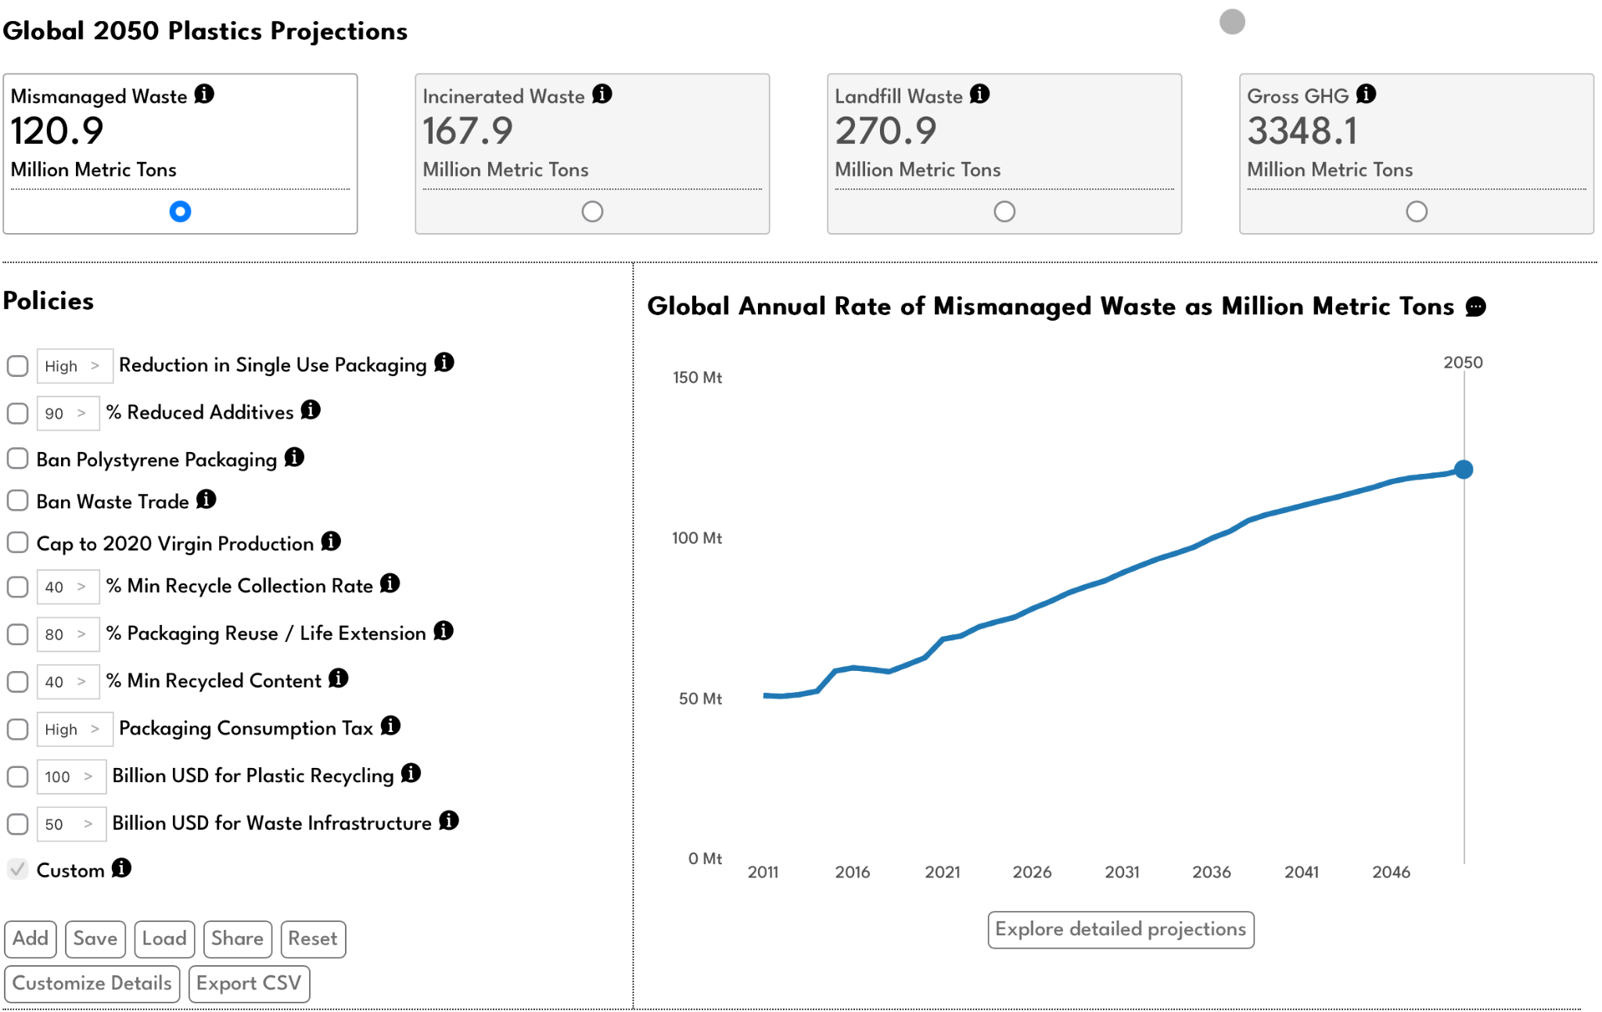
One last thing...
Player loops:
Primary loop: What’s the moment to moment action?
Secondary loop: What’s the medium term goal that is served by the primary loop?
Tertiary loop: What long term goal is served by the primary loop?

Slide 4
Groups and questions
Please sit with your groups (see sticky notes).
Discuss what you thought of the game.
Review the questions in the Zulip together as a group.
Write responses (each member should submit their response to the questions in the main channel with at mention to CourseBot).
Don’t forget the tie-in question.

Slide 5
Citations
G. Nicoli, "Spiritfarer: la morte felice," Ludica, 2020. Available: https://www.ludicamag.com/spiritfarer-la-morte-felice/
A. Pottinger, R. Geyer, N. Biyani, C. Martinez, N. Nathan, M. Morse, M. de Bruyn, C. Boettiger, E. Baker, K. Koy, and D. McCauley, "Global Plastics AI Policy Tool," University of California, 2024. Available: https://global-plastics-tool.org/
A. Pottinger, R. Geyer, N. Biyani, C. Martinez, N. Nathan, M, Morse, C. Liu, S. Hu, M. de Bruyn, C. Boettiger, E. Baker, and D. McCauley, "Pathways to reduce global plastic waste mismanagement and greenhouse gas emissions by 2050," Science, 2024. doi: 10.1126/science.adr3837
"Super Mario Brows. / World 1," Strategy Wiki. Available: https://strategywiki.org/wiki/Super_Mario_Bros./World_1

Slide 6
