Slide 1
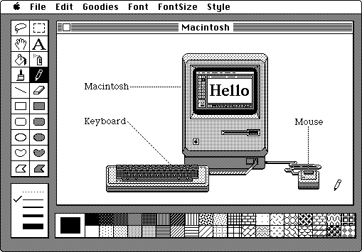
The Reader as Player
A Samuel Pottinger
Stat 198: IDSV
Mar 31, 2025

Slide 2

Acting through tools

Slide 3
Today
> Patterns: common interaction patterns in data visualization.
Group activity: imagine interactions in the census viz.
Formalizing affordances: a generalized language for interaction.

Slide 4
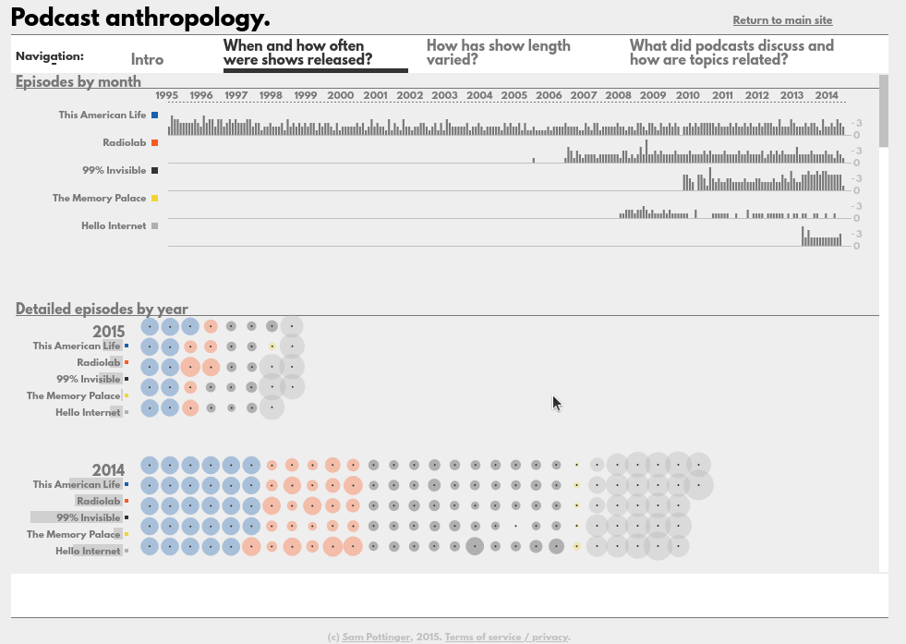
Details Disclosure

Slide 5
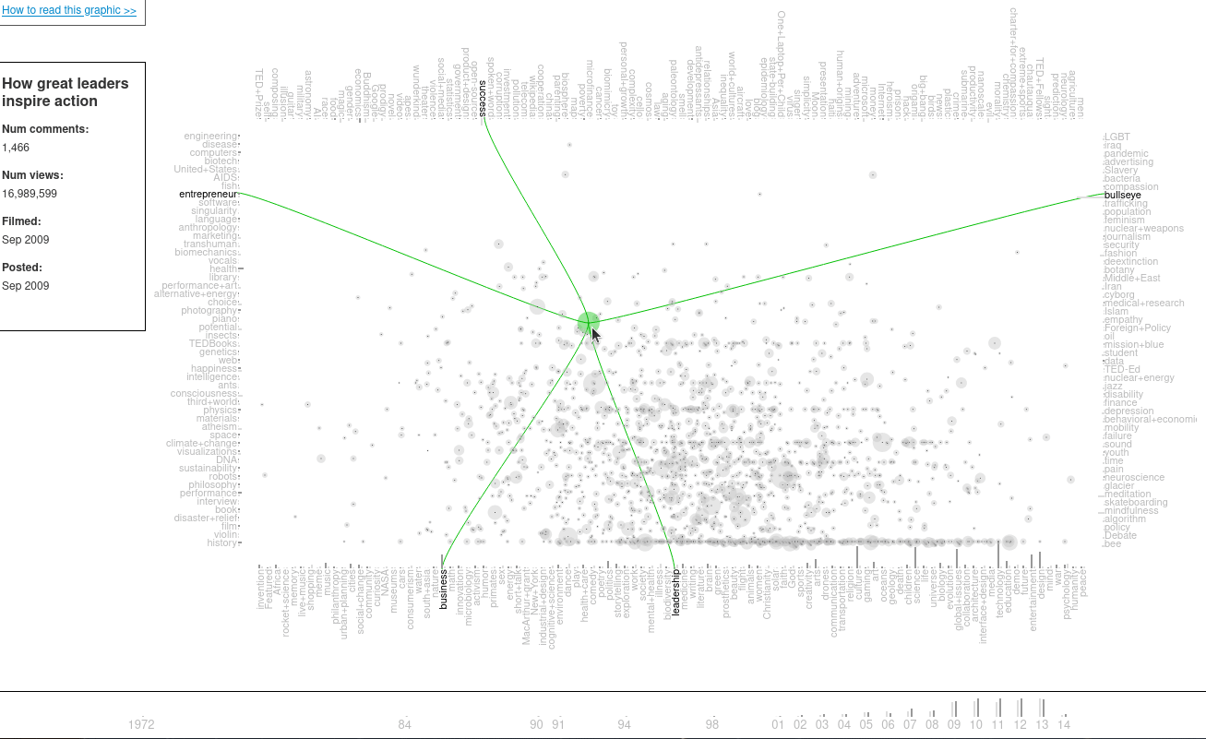
Coordinated Scrubbing

Slide 6
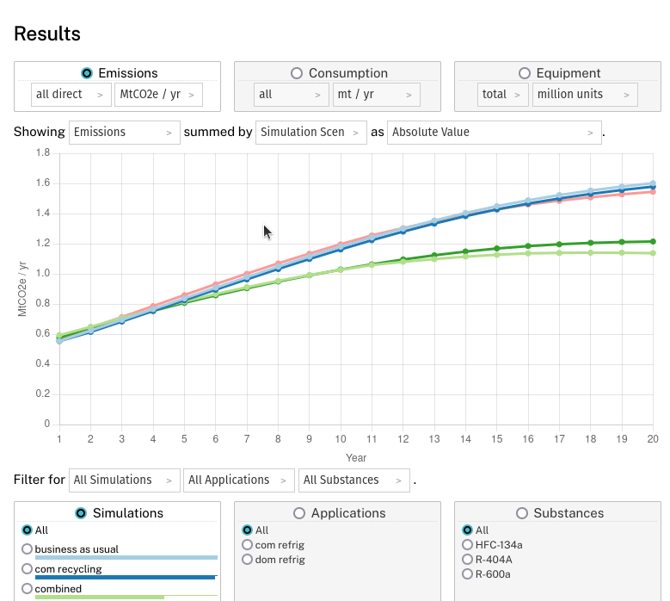
Madlibs

Slide 7
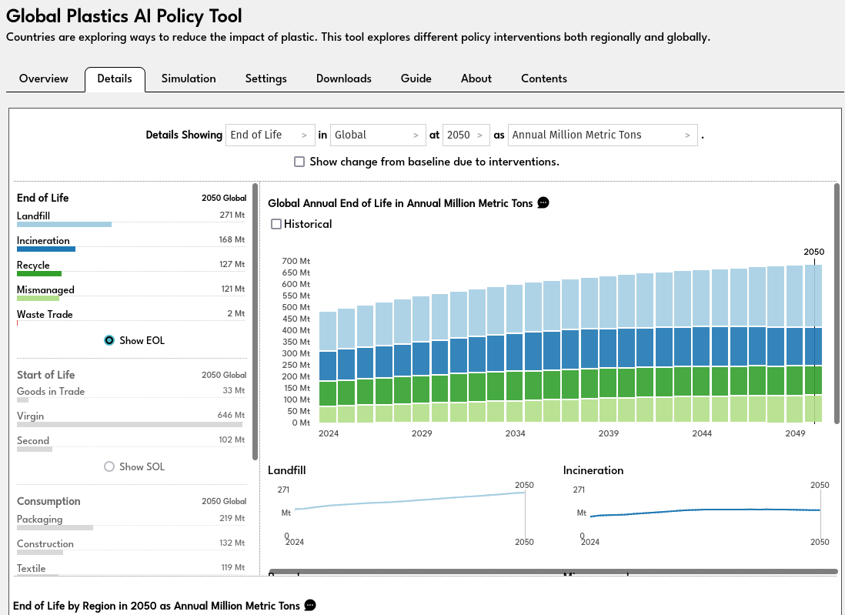
Coordinated Filtering

Slide 8
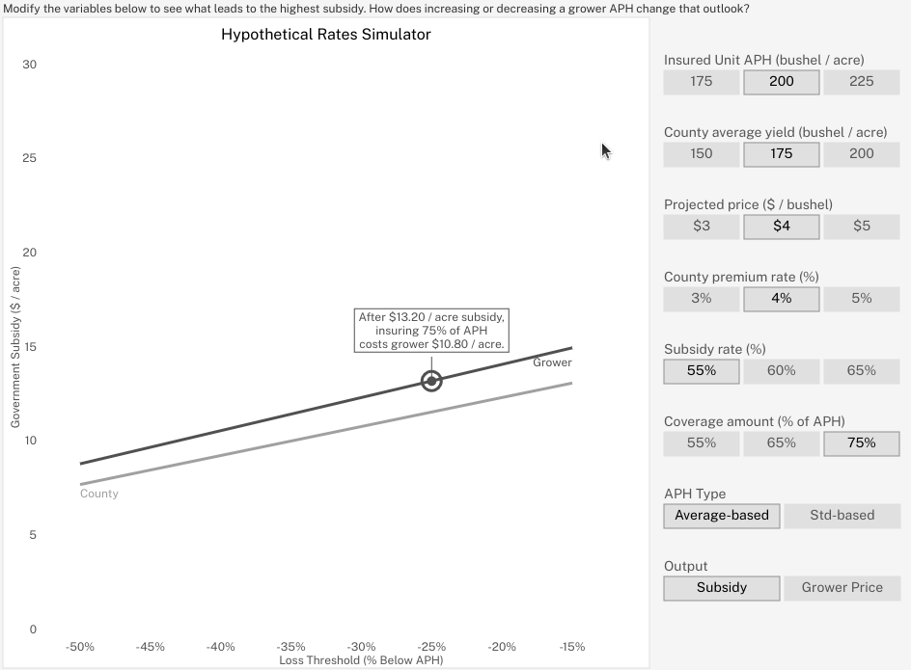
Configuration Panel

Slide 9
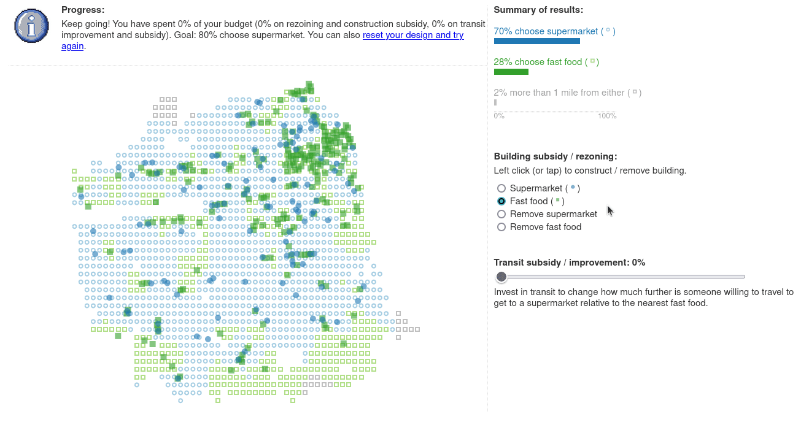
Direct Manipulation

Slide 10
Today
Patterns: common interaction patterns in data visualization.
> Group activity: imagine interactions in the census viz.
Formalizing affordances: a generalized language for interaction.

Slide 11
Today
Patterns: common interaction patterns in data visualization.
Group activity: imagine interactions in the census viz.
Formalizing affordances: a generalized language for interaction.

Slide 12
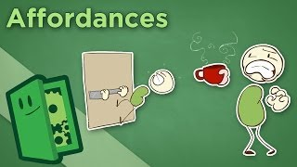
Formalizing Affordances

Slide 13
Formalizing Affordances
Action + Target

Slide 14
Finishing Up
Road to the final.
Please fill out the survey in the Zulip.

Slide 15
Citations
M. Hoekstra, “MacPaint,” Geek Technique, 2007. Available: https://www.geektechnique.org/blog/786/mac-paint.html
J. Portnow, "Kinect Disconnect - How NOT to do Motion Control," Extra Credits, 2012. Available: https://www.youtube.com/watch?v=ijcezUy3ZzY
A. Pottinger, "Podcast Anthropology," Gleap, 2015. Available: https://gleap.org/static/special/podcast_viz/index.html
A. Pottinger, "Ted Viz 2," Gleap, 2013. Available: https://gleap.org/content/ted_visualization_2
A. Pottinger, "Montreal Policy Simulator," University of California, 2025. Available: https://mlf-policy-explorer.org/
A. Pottinger, R. Geyer, N. Biyani, C. Martinez, N. Nathan, M. Morse, M. de Bruyn, C. Boettiger, E. Baker, K. Koy, and D. McCauley, "Global Plastics AI Policy Tool," University of California, 2024. Available: https://global-plastics-tool.org/
A. Pottinger, R. Geyer, N. Biyani, C. Martinez, N. Nathan, M, Morse, C. Liu, S. Hu, M. de Bruyn, C. Boettiger, E. Baker, and D. McCauley, "Pathways to reduce global plastic waste mismanagement and greenhouse gas emissions by 2050," Science, 2024. doi: 10.1126/science.adr3837
A. Pottinger, "FoodSim: San Francisco." 2023. [Online]. Available: https://foodsimsf.com/
J. Portnow, "Affordances - How Design Teaches Us Without Words," Extra Credits, 2014. Available: https://www.youtube.com/watch?v=QCSXEKHL6fc
A. Pottinger, L. Connor, B. Guzder-Williams, M. Weltman-Fahs, N. Gondek, and T. Bowles, "Climate-driven doubling of U.S. maize loss probability: Interactive simulation with neural network Monte Carlo," JDSSV, 2025. doi: 10.52933/jdssv.v5i3.134

Slide 16
