Slide 1
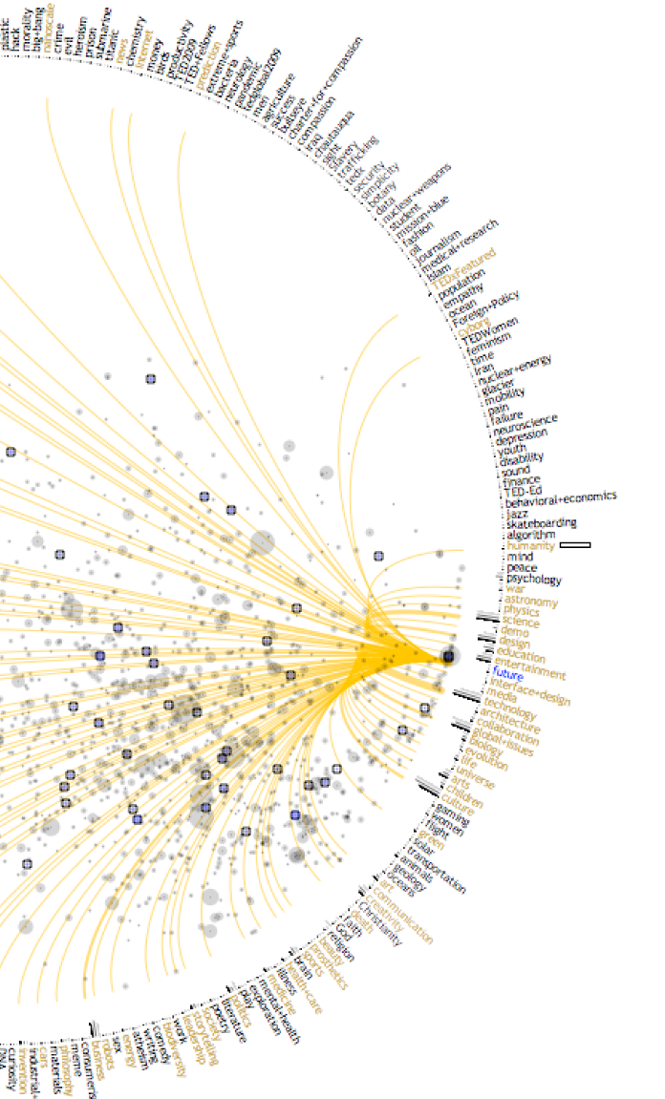
Tasks and Domains
A Samuel Pottinger
Stat 198: IDSV
Mar 12, 2025

Slide 2
Context Setting
Visualization as Representation
Visualization as Task
Visualization as Narrative
Visualization as Dialogue

Slide 3
Today
> Tasks and Domains: Introducing the concept.
Group activity: Revisiting some earlier graphics.
What, Why, How: Optional framework to consider
Looking forward: Upcoming interactive experience

Slide 4
Tasks and domains
Domain / Context
Who is the user?
What social context is that user in?
What are the concepts the user is interacting with?
What prior knowledge or understanding might the user be interacting with?
How are the data produced?

Slide 5
Tasks and domains
Domain / Context
Who is the user?
What social context is that user in?
What are the concepts the user is interacting with?
What prior knowledge or understanding might the user be interacting with?
How are the data produced?
We will talk about how to figure this out in detail but basically the three moves: talk to them, ask them to share their work with you, or share prototypes with them.

Slide 6
Tasks and domains
Domain / Context
Who is the user?
What social context is that user in?
What are the concepts the user is interacting with?
What prior knowledge or understanding might the user be interacting with?
How are the data produced?
Task / Questions
What questions are the users trying to answer or actions are they need to take?
What will the user do with that answer or action?
Why is the task important?
What information is needed to answer that question?

Slide 7
Tasks and domains
Task / Questions
What questions are the users trying to answer or actions are they need to take?
What will the user do with that answer or action?
Why is the task important?
What information is needed to answer that question?
This tells you what to encode and why / with what priority.

Slide 8
Today
Tasks and Domains: Introducing the concept.
> Group activity: Revisiting some earlier graphics.
What, Why, How: Optional framework to consider
Looking forward: Upcoming interactive experience

Slide 9
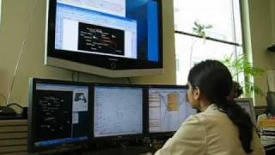
Tasks and domains

Slide 10

Find the domain and tasks

Slide 11
Today
Tasks and Domains: Introducing the concept.
Group activity: Revisiting some earlier graphics.
> What, Why, How: Optional framework to consider
Looking forward: Upcoming interactive experience

Slide 12
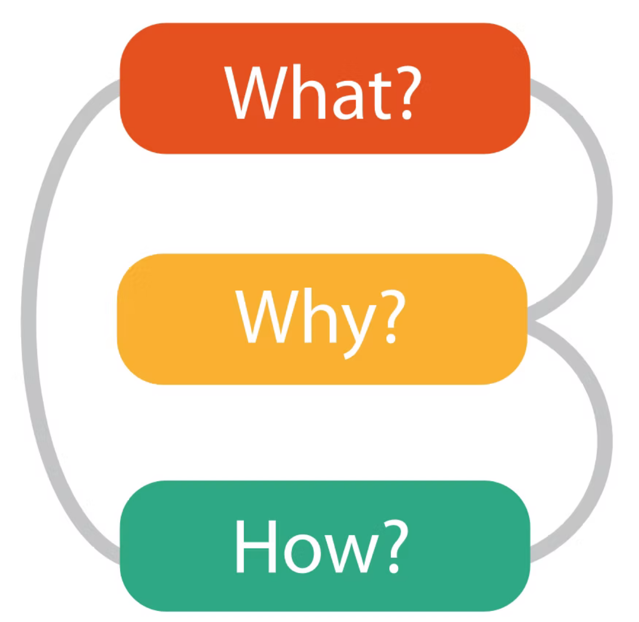
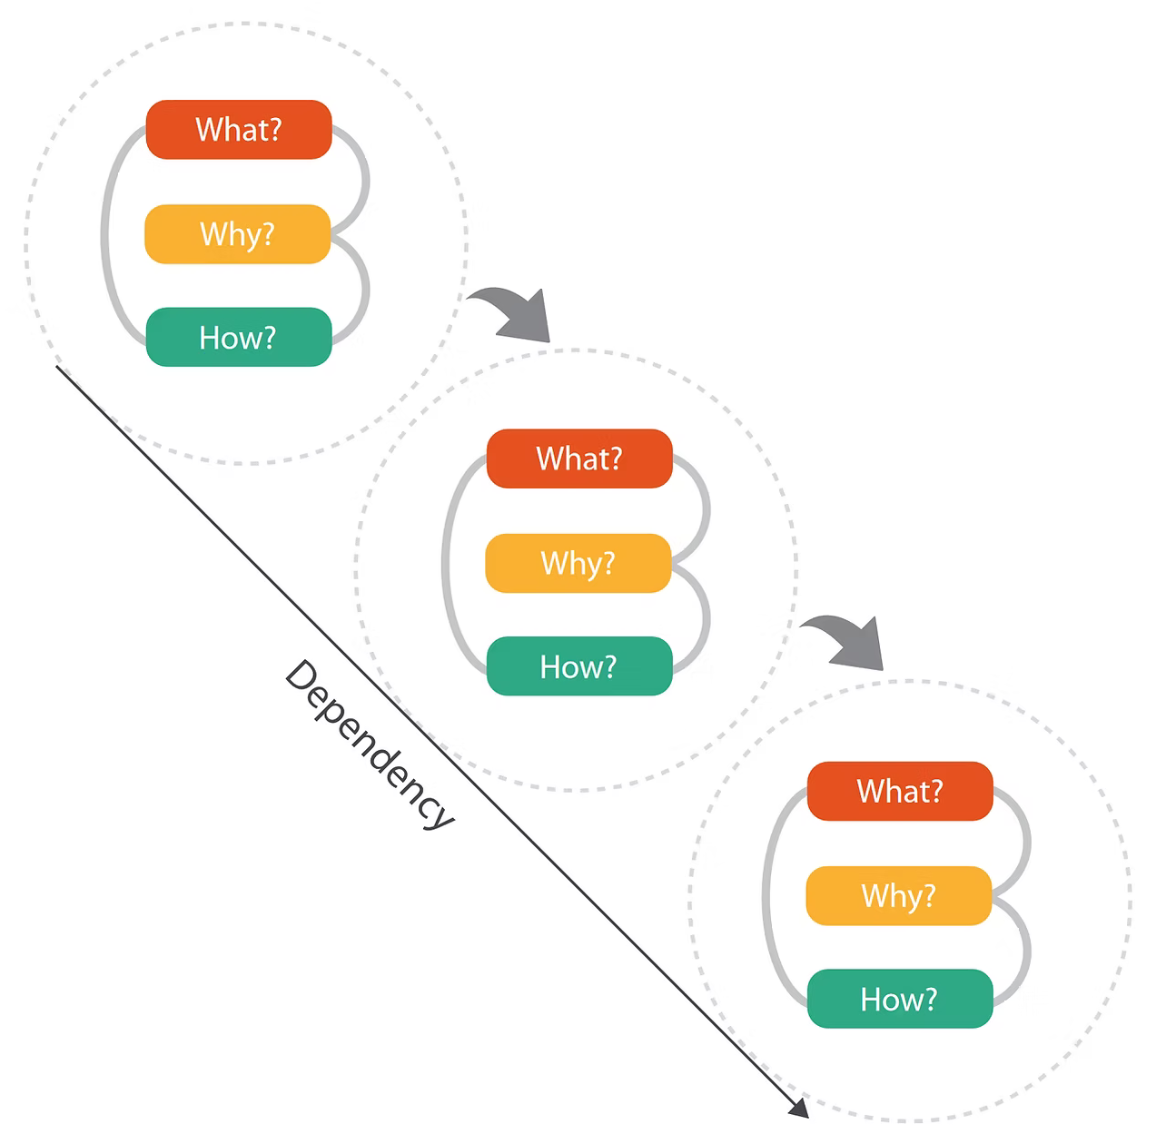
Process from Tamara Munzner

Slide 13
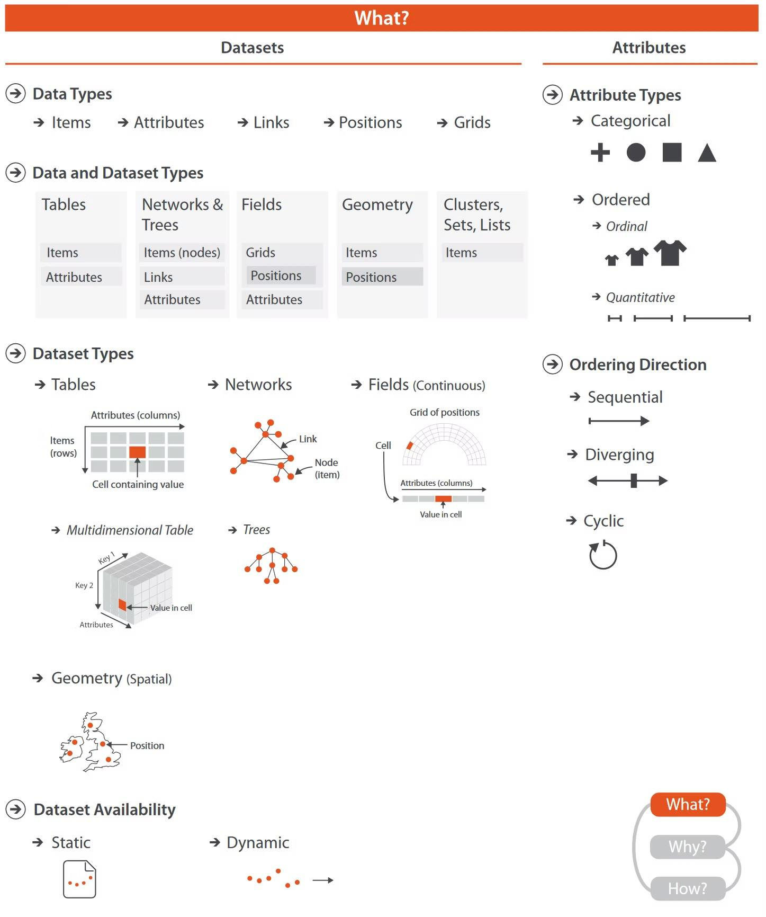
Process from Tamara Munzner
What are the dimensions and measures?
What kinds of data types are those dimensions and measures (nominal, ordinal, continuous)?
In what form are those data?

Slide 14
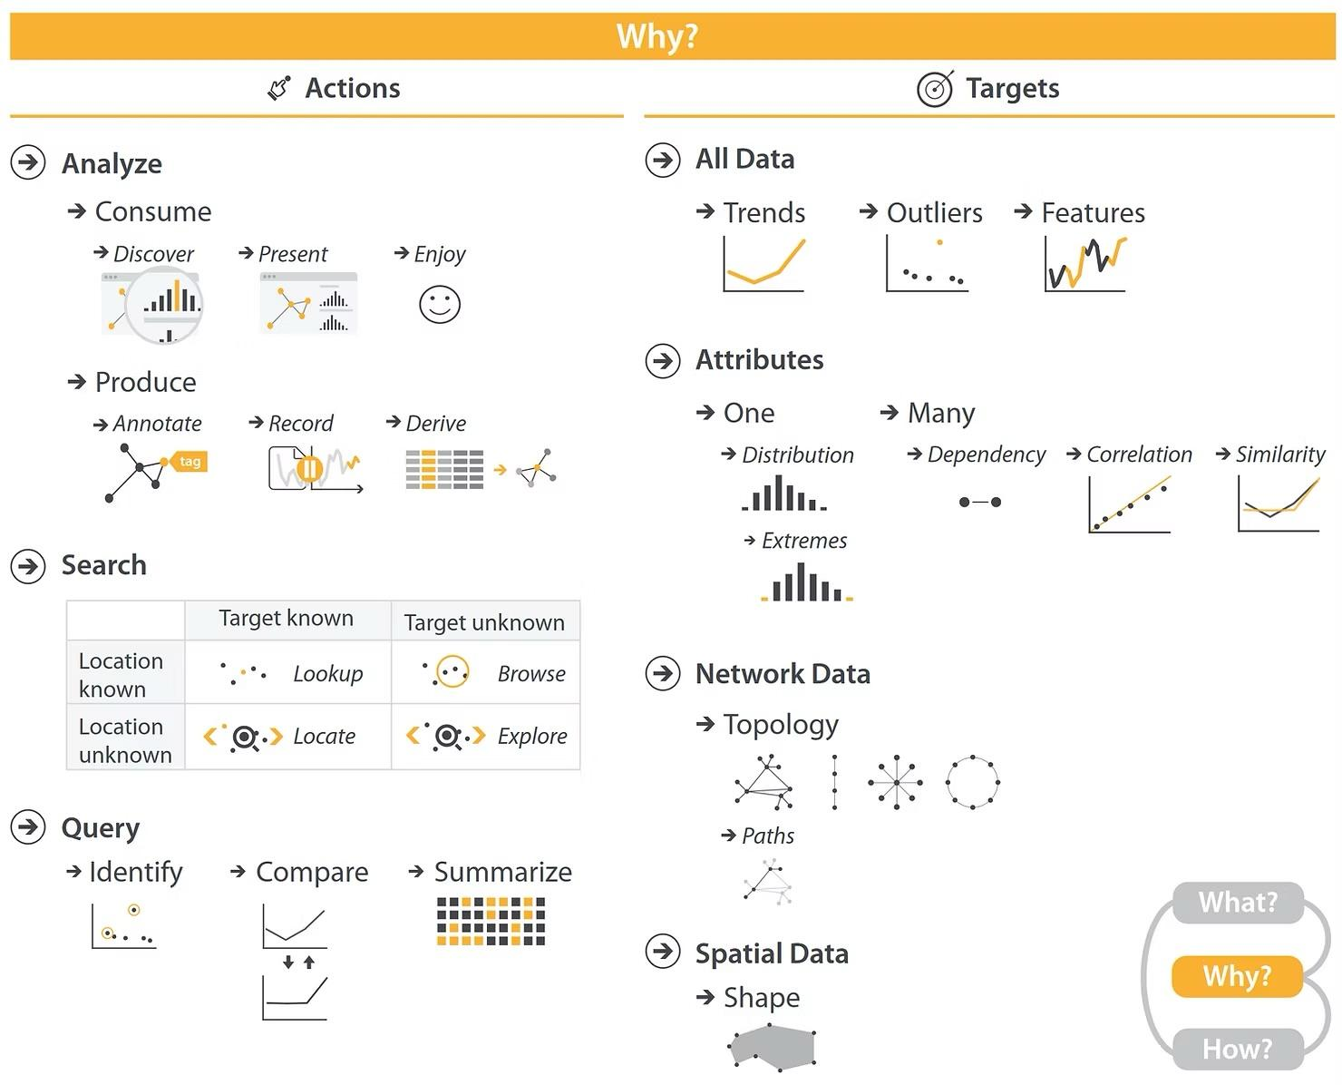
Process from Tamara Munzner
Why is visualization helpful?
What is the motivation for the user in examining these data?
What action or question is the visualization assisting with?

Slide 15
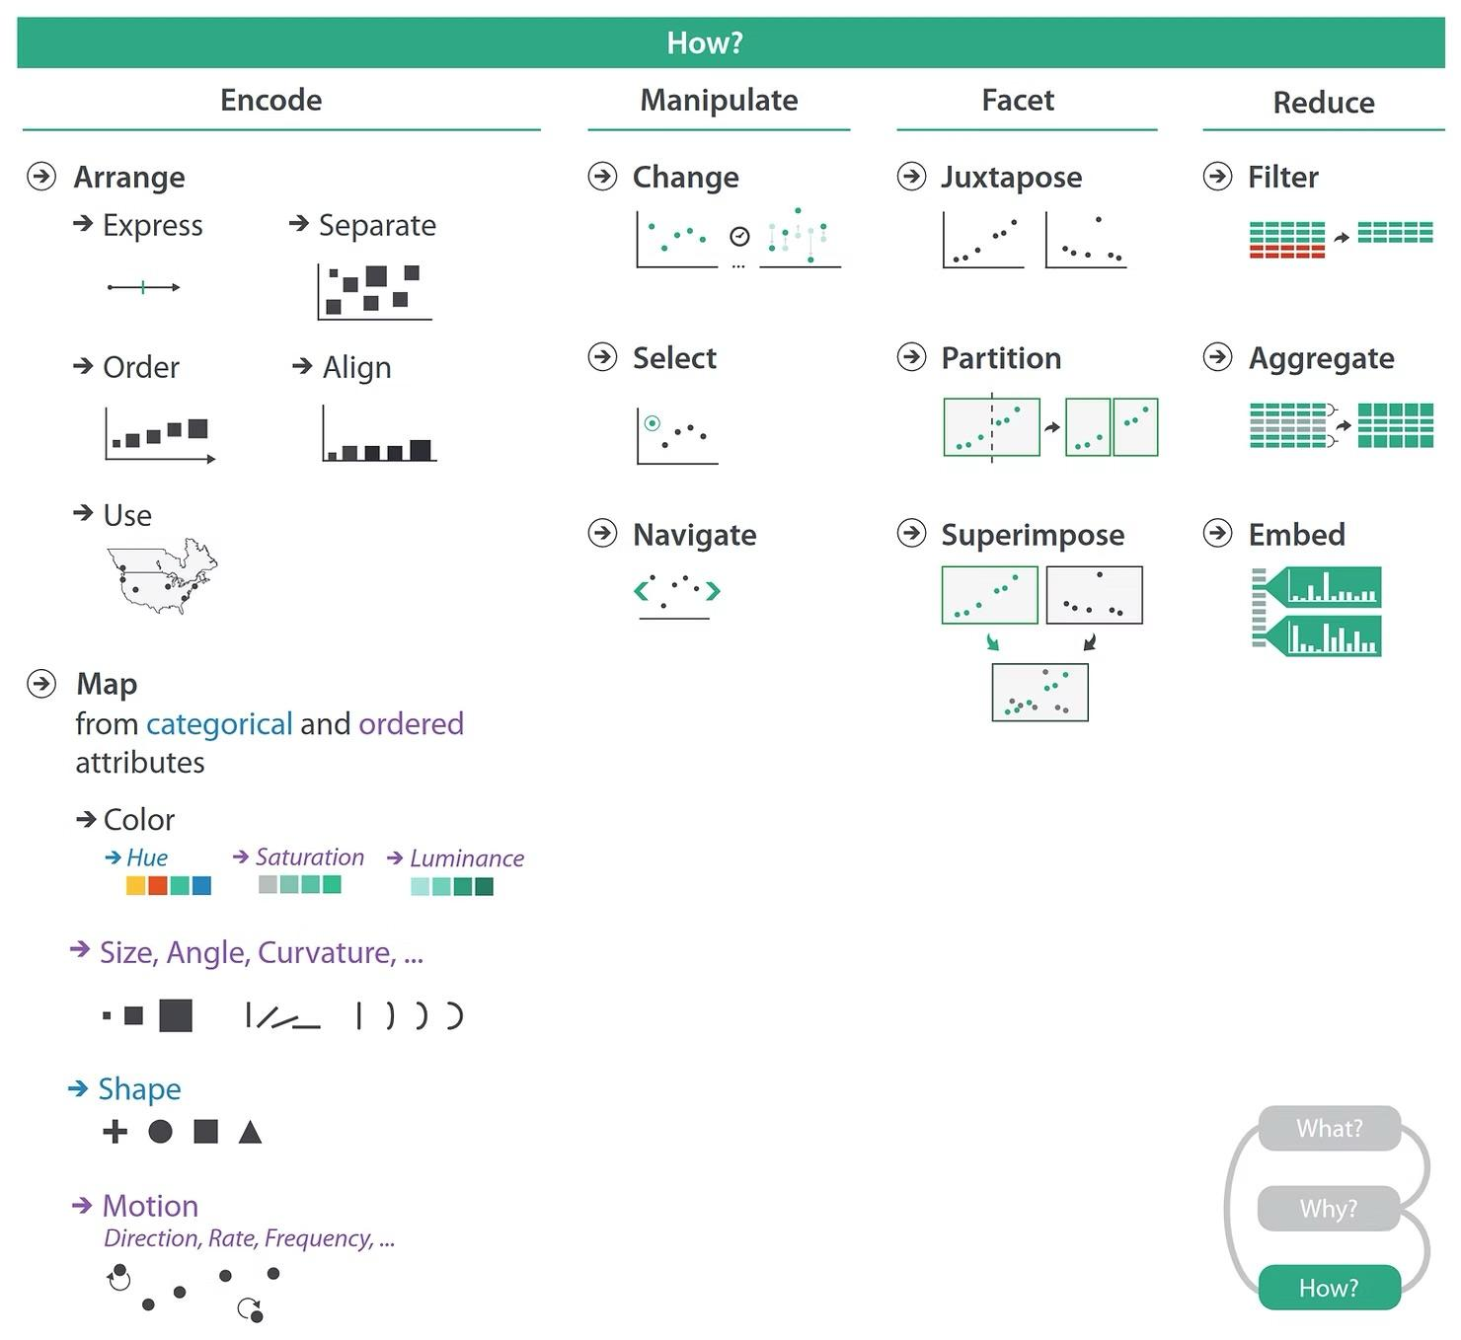
Process from Tamara Munzner
How does the visualization help achieve this goal?
What encodings should be used?
What actions should the user be able to take?

Slide 16
Today
Tasks and Domains: Introducing the concept.
Group activity: Revisiting some earlier graphics.
What, Why, How: Optional framework to consider
> Looking forward: Upcoming interactive experience

Slide 17
Coming Up
Next
Later
User Research
The Player
Measurement / Evaluation
User as co-creator

Slide 18
Homework
Making room due to midterms / requests…
Assignment 12 cancelled
Will move it into additional time for the interactive experience and a bonus reading.

Slide 19
Interactive Experience
1 - Video Game
Well behaved. Violent / non-violent. Short. Can be inexpensive ($7) and played on your phone.
1.1 - In-Class Discussion with grade
1.2 - Zoom Discussion with grade (will be on a Friday 3pm)
2 - Essay
4 different interactive visualizations with 4 sentence response to each prompt.
No cost, browser only needed.
Need you preference by Friday 3pm PT messaged on Zulip.

Slide 20
Citations
T. Munzner, “Visualization Analysis & Design,” University of British Columbia, 2021. Available: https://www.youtube.com/watch?v=pHljd-cgICY
T. Romanowski, “Visualisation Analysis & Design by Tamara Munzner or the What-Why-How of data viz,” Datarocks, 2023. Available: https://www.datarocks.co.nz/post/data-viz-bookshelf_visualization-analysis-design-tamara-munzner
J. Stasko, C. Gorg, Z. Liu, and K. Singhal, “Jigsaw – Visual Analytics,” Georgia Institute of Technology, 2009. Available at: https://youtu.be/2CMw4i9DiaM?feature=shared
R. Binx, “Designing for Realtime Spacecraft Operations,” OpenVisConf, 2016. Available at: https://youtu.be/HuYKhSHcRSQ?feature=shared

Slide 21


