Slide 1
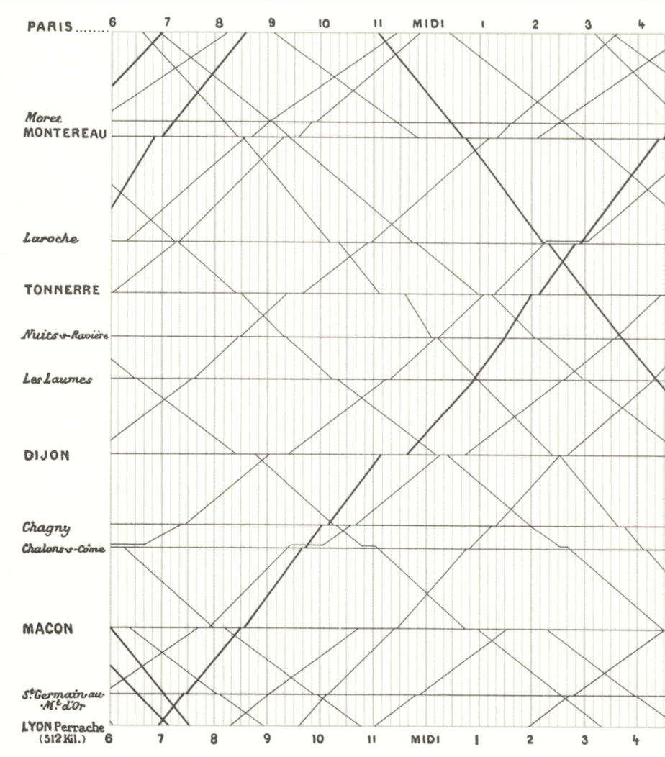
Skills Lab 1
A Samuel Pottinger
Stat 198: IDSV
Jan 29, 2025

Slide 2
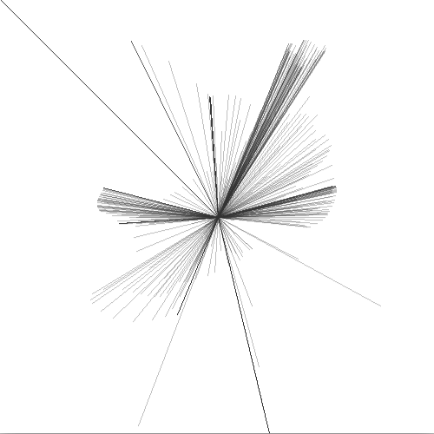
Goal is to get through tutorials 1 and 2.
Tutorial 1 is oriented towards those that have less prior python experience.
Tutorial 2 should be accessible after tutorial 1 but may be quick for those with python expertise.
https://interactivedatascience.courses/labs

Slide 3
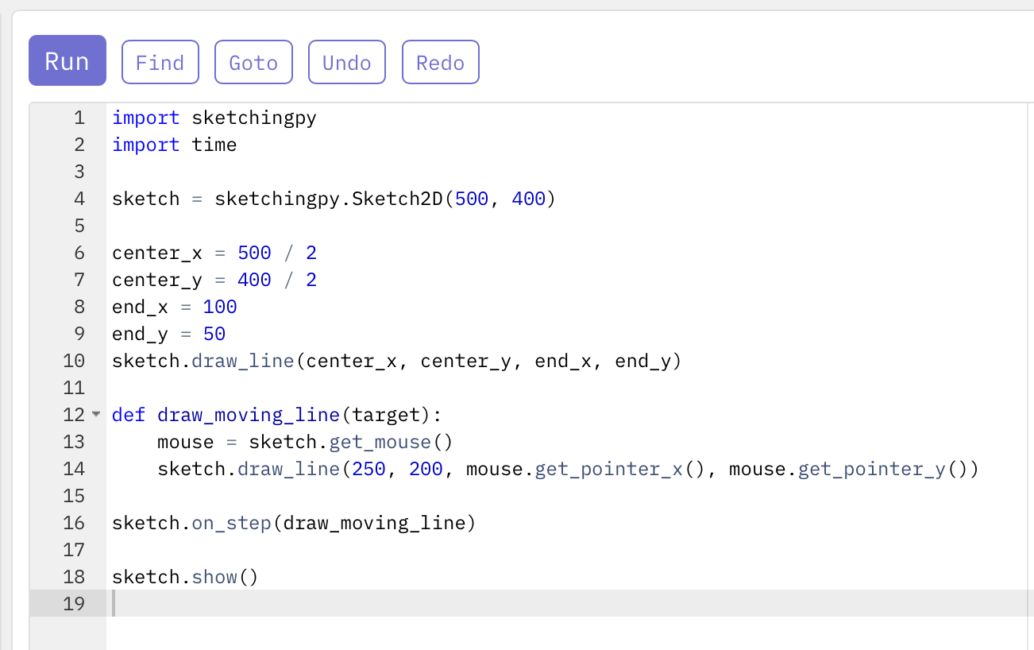
Jupyter Lite and Sketchingpy Sketchbook
Tutorial 1 uses Jupyter Lite.
Tutorial 2 uses the Sketchingpy sketchbook.
You only need a web browser.

Slide 4
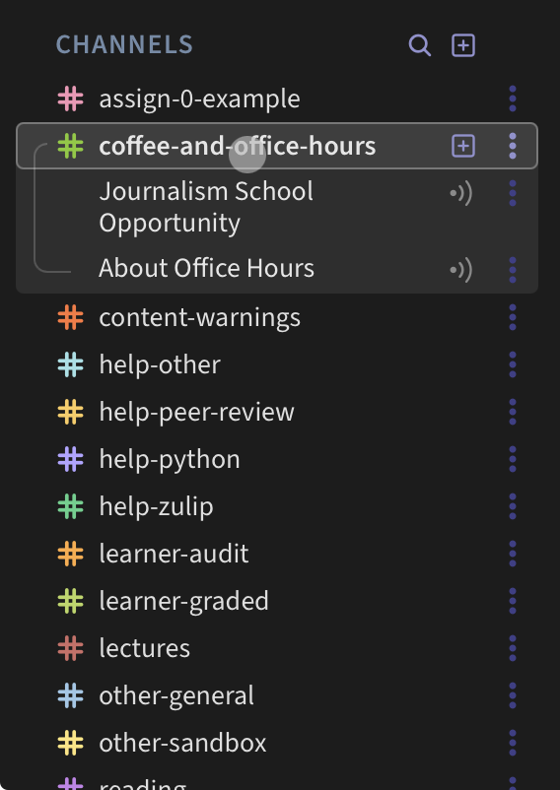
Flipped Classroom

Slide 5
Sources for imagery
https://badriadhikari.github.io/data-viz-workshop-2021/minards/

Slide 6
